Slide 1
DEEP Learning
- By Ashwin Surse

Slide 2
Deep learning
Deep learning is based on the branch of machine learning, which is a subset of artificial intelligence. Since neural networks imitate the human brain and so deep learning will do. In deep learning, nothing is programmed explicitly. Basically, it is a machine learning class that makes use of numerous nonlinear processing units so as to perform feature extraction as well as transformation. The output from each preceding layer is taken as input by each one of the successive layers.

Slide 3
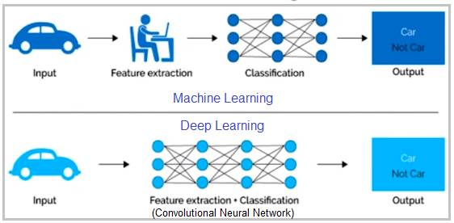

Slide 4
Types of Learning:
1) Supervised: Learning with a labaled training data set.
2) Unsupervised: Discover patterns in unlabeled data set.
3) Reinforcement Learning: It will learn from Supervised and unsupervised data and act.

Slide 5
Advantage:
Features are automatically deduced and optimally tuned for desired outcome. Features are not required to be extracted ahead of time. This avoids time consuming machine learning techniques
Robustness to natural variations in the data is automatically learned.
The deep learning architecture is flexible to be adapted to new problems in the future.
Disadvantage:
It requires very large amount of data in order to perform better than other techniques.
It is extremely expensive to train due to complex data models. Moreover deep learning requires expensive GPUs and hundreds of machines. This increases cost to the users.

Slide 6
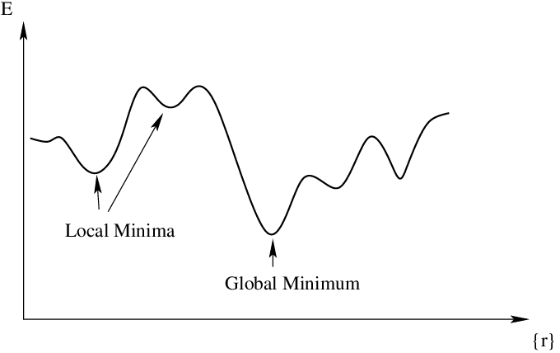
Global and Local Minima:
The point at which a function takes the minimum value is called as global minima.
several points which appear to be minima but is not the point where the function actually takes the minimum value is called as local minima.

Slide 7
Neural Networks
A deep neural network (DNN) is an ANN with multiple hidden layers between the input and output layers.
DNNs can model complex non-linear relationships.
The main purpose of a neural network is to receive a set of inputs, perform progressively complex calculations on them, and give output to solve real world problems like classification.
Neural networks are widely used in supervised learning and reinforcement learning problems. These networks are based on a set of layers connected to each other.

Slide 8
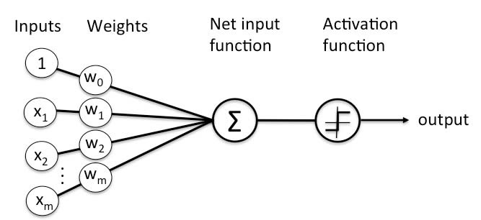
Single layer - Single layer perceptrons can learn only linearly separable patterns
Multilayer - Multilayer perceptrons or feedforward neural networks with two or more layers have the greater processing power

Slide 9
A Perceptron accepts inputs, moderates them with certain weight values, then applies the transformation function to output the final result. The image below shows a Perceptron with a Boolean output.
Activation Function:
Activation functions are mathematical equations that determine the output of a neural network model. Activation functions also have a major effect on the neural network’s ability to converge and the convergence speed.
Activation function must be efficient and it should reduce the computation time because the neural network sometimes trained on millions of data points.

Slide 10
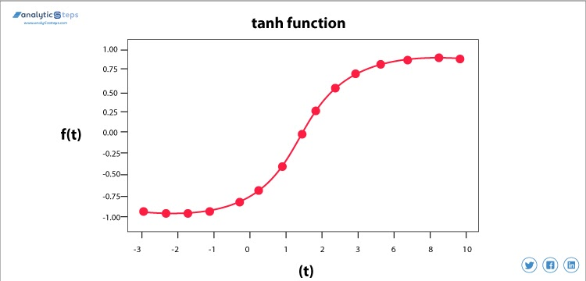
Hyperbolic Tangent Activation Function(Tanh)
This activation function is slightly better than the sigmoid function, like the sigmoid function it is also used to predict or to differentiate between two classes but it maps the negative input into negative quantity only and ranges in between -1 to 1.

Slide 11
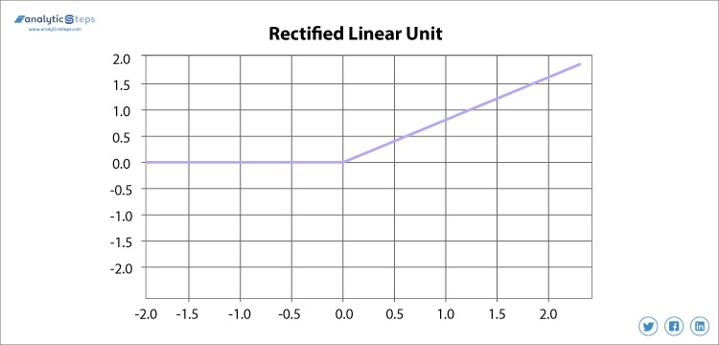
ReLU( Rectified Linear unit)
Rectified linear unit or ReLU is most widely used activation function right now which ranges from 0 to infinity, All the negative values are converted into zero, and this conversion rate is so fast that neither it can map nor fit into data properly which creates a problem, but where there is a problem there is a solution.

Slide 12
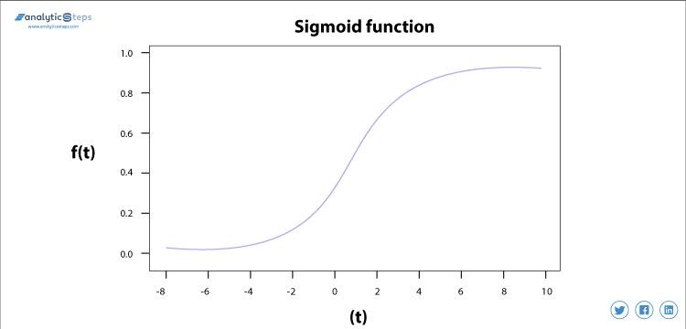
Sigmoid Activation Function
The sigmoid activation function is used mostly as it does its task with great efficiency, it basically is a probabilistic approach towards decision making and ranges in between 0 to 1, so when we have to make a decision or to predict an output we use this activation function because of the range is the minimum, therefore, prediction would be more accurate.

Slide 13
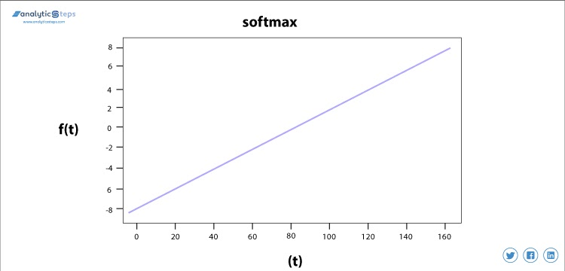
Softmax Activation Function
Softmax is used mainly at the last layer i.e output layer for decision making the same as sigmoid activation works, the softmax basically gives value to the input variable according to their weight and the sum of these weights is eventually one.
For Binary classification, both sigmoid, as well as softmax, are equally approachable but in case of multi-class classification problem we generally use softmax and cross-entropy along with it.

Slide 14
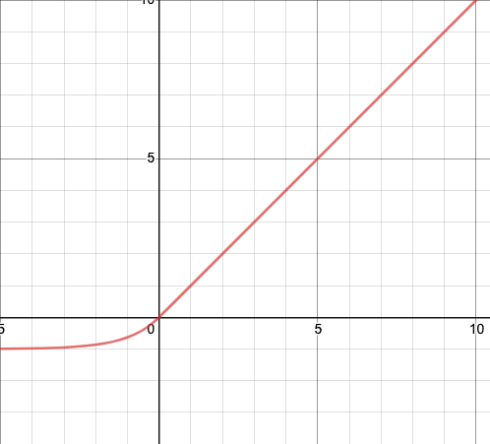
ELU (Exponential Linear Unit)
ELU is an activation function based on ReLU that has an extra alpha constant (α) that defines function smoothness when inputs are negative.
The ELU output for positive input is the input (identity). If the input is negative, the output curve is slightly smoothed towards the alpha constant (α). The higher the alpha constant, the more negative the output for negative inputs gets.

Slide 15
Artificial Neural Networks (ANN)
Artificial Neural Networks (ANN) are multi-layer fully-connected neural nets that look like the figure below. They consist of an input layer, multiple hidden layers, and an output layer. Every node in one layer is connected to every other node in the next layer. We make the network deeper by increasing the number of hidden layers.

Slide 16
What is Backpropagation
Backpropagation is the essence of neural network training. It is the method of fine-tuning the weights of a neural network based on the error rate obtained in the previous epoch (i.e., iteration). Proper tuning of the weights allows you to reduce error rates and make the model reliable by increasing its generalization.
Backpropagation in neural network is a short form for “backward propagation of errors.” It is a standard method of training artificial neural networks. This method helps calculate the gradient of a loss function with respect to all the weights in the network.

Slide 17
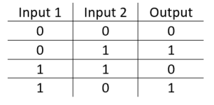
The XOr Problem
The XOr, or “exclusive or”, problem is a classic problem in ANN research. It is the problem of using a neural network to predict the outputs of XOr logic gates given two binary inputs. An XOr function should return a true value if the two inputs are not equal and a false value if they are equal. All possible inputs and predicted outputs are

Slide 18
cost function
A neural network is a machine learning algorithm that takes in multiple inputs, runs them through an algorithm, and essentially sums the output of the different algorithms to get the final output.
The cost function of a neural network will be the sum of errors in each layer. This is done by finding the error at each layer first and then summing the individual error to get the total error.

Slide 19
What Is Gradient Descent
Gradient Descent is an algorithm that is used to optimize the cost function or the error of the model. It is used to find the minimum value of error possible in your model.
Gradient Descent can be thought of as the direction you have to take to reach the least possible error. The error in your model can be different at different points, and you have to find the quickest way to minimize it, to prevent resource wastage.
Gradient Descent can be visualized as a ball rolling down a hill. Here, the ball will roll to the lowest point on the hill. It can take this point as the point where the error is least as for any model, the error will be minimum at one point and will increase again after that.

Slide 20
1. Batch Gradient Descent
Suppose we have dataset having n training set inputs.When we will send all the training set input data to calculate the attributes is known as batch gradient descent.
2. Mini Batch Gradient Descent
Suppose we have 1000 datapoints in a dataset .In MGD unlike BGD we won’t calculate loss for whole dataset but we randomly select small-small batch of datapoints ideally in a range of 50–256 and then we calculate attributes.

Slide 21
Convolutional neural network (CNN)
A convolutional neural network is a specific kind of neural network with multiple layers. It processes data that has a grid-like arrangement then extracts important features. One huge advantage of using CNNs is that you don't need to do a lot of pre-processing on images.
CNNs can learn what characteristics in the filters are the most important. That saves a lot of time and trial and error work since we don't need as many parameters.
A big difference between a CNN and a regular neural network is that CNNs use convolutions to handle the math behind the scenes. A convolution is used instead of matrix multiplication in at least one layer of the CNN. Convolutions take to two functions and return a function.

Slide 22
How Convolutional Neural Networks Work
Convolutional neural networks are based on neuroscience findings. They are made of layers of artificial neurons called nodes. These nodes are functions that calculate the weighted sum of the inputs and return an activation map. This is the convolution part of the neural network.
Each node in a layer is defined by its weight values. When you give a layer some data, like an image, it takes the pixel values and picks out some of the visual features.
When you're working with data in a CNN, each layer returns activation maps. These maps point out important features in the data set. If you gave the CNN an image, it'll point out features based on pixel values, like colors, and give you an activation function.

Slide 23
Convolutional Neural Network has three layers,
Input: If the image consists of 32 widths, 32 height encompassing three R, G, B channels, then it will hold the raw pixel([32x32x3]) values of an image.
Convolution: It computes the output of those neurons, which are associated with input's local regions, such that each neuron will calculate a dot product in between weights and a small region to which they are actually linked to in the input volume. For example, if we choose to incorporate 12 filters, then it will result in a volume of [32x32x12].

Slide 24
ReLU Layer: It is specially used to apply an activation function elementwise, like as max (0, x) thresholding at zero. It results in ([32x32x12]), which relates to an unchanged size of the volume.
Pooling: This layer is used to perform a downsampling operation along the spatial dimensions (width, height) that results in [16x16x12] volume.

Slide 25
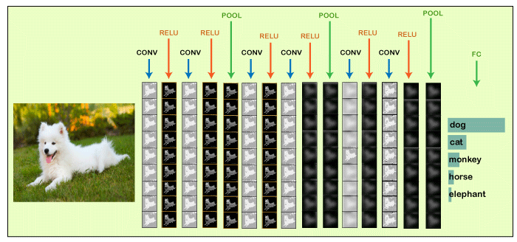
CNN
Locally Connected: It can be defined as a regular neural network layer that receives an input from the preceding layer followed by computing the class scores and results in a 1-Dimensional array that has the equal size to that of the number of classes.
We will start with an input image to which we will be applying multiple feature detectors, which are also called as filters to create the feature maps that comprises of a Convolution layer. Then on the top of that layer, we will be applying the ReLU or Rectified Linear Unit to remove any linearity or increase non-linearity in our images.

Slide 26
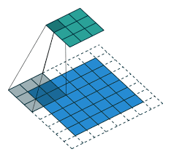
Padding
To build a deep neural network, we need to be familiar with the basic convolutional operations such as padding, strides, pooling.
In convolutional neural network, a convolutional layer is applied to one or more filters to an input in order to generate output. The input is typically 3-dimensional images (height, width, channels) while the filters are also 3-dimensional shape with the same number of channels and different heights and widths.
There are two common convolution types: valid and same convolutions.

Slide 27
Activation function
For every neural network we have to apply activation function to find out which node should be fired, in other terms to match the output nodes we have to apply different nonlinearities by using these activation function on each layer. In Convolutional neural network we apply mostly RELU(not compulsory we can use different activation function) activation function which replace the all negative values to 0 and remains same with the positive values.

Slide 28
Pooling
The pooling operation involves sliding a two-dimensional filter over each channel of feature map and summarising the features lying within the region covered by the filter.
Pooling layers are used to reduce the dimensions of the feature maps. Thus, it reduces the number of parameters to learn and the amount of computation performed in the network.
The pooling layer summarises the features present in a region of the feature map generated by a convolution layer.

Slide 29
Types of Pooling Layers
Max Pooling
Max pooling is a pooling operation that selects the maximum element from the region of the feature map covered by the filter. Thus, the output after max-pooling layer would be a feature map containing the most prominent features of the previous feature map.
Average Pooling
Average pooling computes the average of the elements present in the region of feature map covered by the filter. Thus, while max pooling gives the most prominent feature in a particular patch of the feature map, average pooling gives the average of features present in a patch.

Slide 30
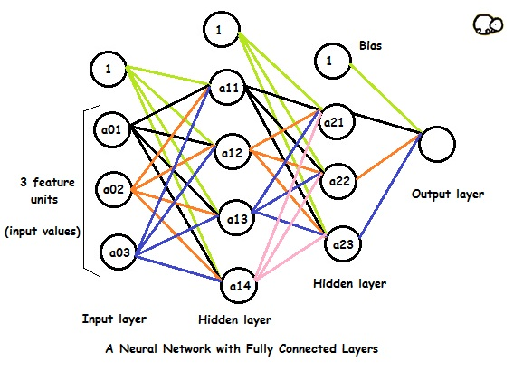
Fully Connected layers
Fully Connected layers in a neural networks are those layers where all the inputs from one layer are connected to every activation unit of the next layer. In most popular machine learning models, the last few layers are full connected layers which compiles the data extracted by previous layers to form the final output. It is the second most time consuming layer second to Convolution Layer.

Slide 31
We can divide the whole neural network (for classification) into two parts:
Feature extraction: In the conventional classification algorithms, like SVMs, we used to extract features from the data to make the classification work. The convolutional layers are serving the same purpose of feature extraction.
Classification: After feature extraction we need to classify the data into various classes, this can be done using a fully connected (FC) neural network. In place of fully connected layers, we can also use a conventional classifier like SVM.

Slide 32
LeNet-5
LeNet-5 was developed by one of the pioneers of deep learning Yann LeCun in 1998 in his paper ‘Gradient-Based Learning Applied to Document Recognition’. LeNet was used in detecting handwritten cheques by banks based on MNIST dataset. Fully connected networks and activation functions were previously known in neural networks. LeNet-5 introduced convolutional and pooling layers. LeNet-5 is believed to be the base for all other ConvNets.
LeNet-5 consists of 7 layers – alternatingly 2 convolutional and 2 average pooling layers, and then 2 fully connected layers and the output layer with activation function softmax.

Slide 33
AlexNet
AlexNet is the name of a convolutional neural network which has had a large impact on the field of machine learning, specifically in the application of deep learning to machine vision. It famously won the 2012 ImageNet LSVRC-2012 competition by a large margin.
The network had a very similar architecture as LeNet by Yann LeCun et al but was deeper, with more filters per layer, and with stacked convolutional layers.
Key Points
Relu activation function is used instead of Tanh to add non-linearity. It accelerates the speed by 6 times at the same accuracy.
Use dropout instead of regularisation to deal with overfitting. However, the training time is doubled with the dropout rate of 0.5.
Overlap pooling to reduce the size of the network. It reduces the top-1 and top-5 error rates by 0.4% and 0.3%, respectively.

Slide 34
VGGNet
The runner-up at the ILSVRC 2014 competition is dubbed VGGNet by the community and was developed by Simonyan and Zisserman. VGGNet consists of 16 convolutional layers and is very appealing because of its very uniform architecture. Similar to AlexNet, only 3x3 convolutions, but lots of filters.
It is currently the most preferred choice in the community for extracting features from images.

Slide 35
ResNet
At the ILSVRC 2015, the so-called Residual Neural Network (ResNet) by Kaiming He et al introduced anovel architecture with “skip connections” and features heavy batch normalization. Such skip connections are also known as gated units or gated recurrent units and have a strong similarity to recent successful elements applied in RNNs. This technique they were able to train a NN with 152 layers while still having lower complexity than VGGNet.
AlexNet has parallel two CNN line trained on two GPUs with cross-connections, GoogleNet has inception modules ,ResNet has residual connections.

Slide 36
GoogLeNet
The ILSVRC 2014 competition was GoogLeNet(a.k.a. Inception V1) from Google. It achieved a top-5 error rate of 6.67%! This was very close to human level performance which the organisers of the challenge were now forced to evaluate. As it turns out, this was actually rather hard to do and required some human training in order to beat GoogLeNets accuracy.
The network used a CNN inspired by LeNet but implemented a novel element which is dubbed an inception module. It used batch normalization, image distortions and RMSprop.

Slide 37
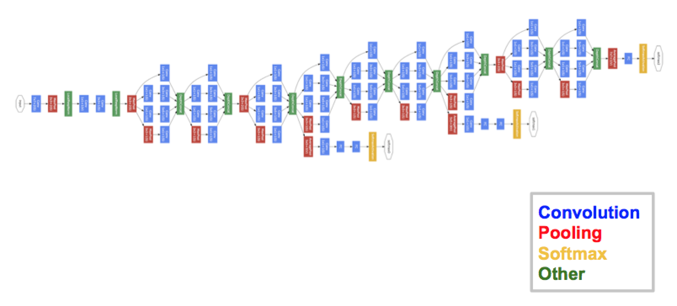
This module is based on several very small convolutions in order to drastically reduce the number of parameters. Their architecture consisted of a 22 layer deep CNN but reduced the number of parameters from 60 million (AlexNet) to 4 million.

Slide 38
TensorFlow
TensorFlow is one of the famous deep learning framework, developed by Google Team. It is a free and open source software library and designed in Python programming language, this tutorial is designed in such a way that we can easily implement deep learning project on TensorFlow in an easy and efficient way.
TensorFlow can train and run the deep neural networks for image recognition, handwritten digit classification, recurrent neural network, word embedding, natural language processing, video detection, and many more. TensorFlow is run on multiple CPUs or GPUs and also mobile operating systems.

Slide 39
The word TensorFlow is made by two words, i.e., Tensor and Flow
Tensor is a multidimensional array
Flow is used to define the flow of data in operation.
Advantages
It was fixed to run on multiple CPUs or GPUs and mobile operating systems.
The portability of the graph allows to conserve the computations for current or later use. The graph can be saved because it can be executed in the future.
All the computation in the graph is done by connecting tensors together.

Slide 40
Why is TensorFlow popular
TensorFlow is the better library for all because it is accessible to everyone. TensorFlow library integrates different API to create a scale deep learning architecture like CNN (Convolutional Neural Network) or RNN (Recurrent Neural Network).
TensorFlow is based on graph computation; it can allow the developer to create the construction of the neural network with Tensorboard. This tool helps debug our program. It runs on CPU (Central Processing Unit) and GPU (Graphical Processing Unit).
TensorFlow has an interactive multiplatform programming interface which is scalable and reliable compared to other deep learning libraries which are available.

Slide 41
Architecture of TensorFlow
The TensorFlow runtime is a cross-platform library. The system architecture which makes this combination of scale flexible. We have basic familiarity with TensorFlow programming concepts such as the computation graph, operations, and sessions.
Some terms need to be understood first to understand TensorFlow architecture. The terms are TensorFlow Servable, servable Streams, TensorFlow Models, Loaders, Sources, Manager, and Core. The term and their functionality in the architecture of TensorFlow are described below.

Slide 42
Advantages of TensorFlow
Graphs:
TensorFlow has better computational graph visualizations. Which are inherent when compared to other libraries like Torch and Theano.
Library management:
Google backs it. And has the advantages of seamless performance, quick updates, and frequent new releases with new features.
Scalability:
The libraries are deployed on a hardware machine, which is a cellular device to the computer with a complex setup.
TensorFlow has excellent community support.
Its performance is high and matching the best in the industry.

Slide 43
Disadvantages of TensorFlow
Missing Symbolic loops:
When we say about the variable-length sequence, the feature is more required. Unfortunately, TensorFlow does not offer functionality, but finite folding is the right solution to it.
It requires fundamental knowledge of advanced calculus and linear algebra along with a good understanding of machine learning also.
TensorFlow has a unique structure, so it's hard to find an error and difficult to debug.
There is no need for any super low-level matter.

Slide 44
What is Pytorch
PyTorch is a small part of a computer software which is based on Torch library. It is a Deep Learning framework introduced by Facebook. PyTorch is a Machine Learning Library for Python programming language which is used for applications such as Natural Language Processing.
The high-level features which are provided by PyTorch are as follows:
With the help of the Graphics Processing Unit (GPU), it gives tensor computing with strong acceleration.
It provides Deep Neural Network which is built on a tape-based auto diff system.

Slide 45
PyTorch was developed to provide high flexibility and speed during implementing and building the Deep Learning Neural Network. As you already know, it is a machine learning library for Python programming language, so it's quite simple to install, run, and understand. Pytorch is completely pythonic (using widely adopted python idioms rather than writing Java and C++ code) so that it can quickly build a Neural Network Model successfully.
What is special in PyTorch which makes it special to build Deep learning model. PyTorch is a dynamic library. Dynamic library means a flexible library, and you can use that library as per your requirements and changes. At present in Kaggle competition, it is continuously used by finishers.

Slide 46
PyTorch is an optimized tensor library for deep learning using CPUs and GPUs. PyTorch has a rich set of packages which are used to perform deep learning concepts. These packages help us in optimization, conversion, and loss calculation, etc.
PyTorch is a framework of deep learning, and it is a Python machine learning package based on PyTorch. we can easily implement deep learning project on PyTorch in a very efficient way.

Slide 47
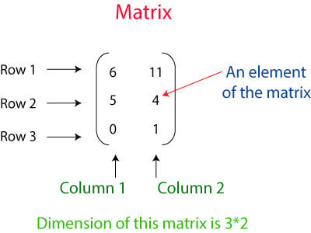
Tensors are the key components of Pytorch. We can say PyTorch is completely based on the Tensors. In mathematical term, a rectangular array of number is called a metrics. In the Numpy library, these metrics called ndaaray. In PyTorch, it is known as Tensor. A Tensor is an n-dimensional data container. For example, In PyTorch, 1d-Tensor is a vector, 2d-Tensor is a metrics, 3d- Tensor is a cube, and 4d-Tensor is a cube vector.

Slide 48
Keras
Keras has come up with two types of in-built models; Sequential Model and an advanced Model class with functional API. The Sequential model tends to be one of the simplest models as it constitutes a linear set of layers, whereas the functional API model leads to the creation of an arbitrary network structure.
The layers within the sequential models are sequentially arranged, so it is known as Sequential API. In most of the Artificial Neural Network, the layers are sequentially arranged, such that the data flow in between layers is in a specified sequence until it hit the output layer.

Slide 49
At first the model is compiled for which the compile process is used for constructing the learning procedure afterward the model undergoes the training in the next step. The compilation include three parameter, which are as follows:
An optimizer: As the name suggest, an optimizer can be a string of an existing optimizer like (rmsprop or adagrad), or simply an instance of class optimizer.
A loss function: A loss function act as an objective that every model tries to minimize for example categorical_crossentropy or mse. It is also known as objective function.
A list of metrics: A list of metrics refers to a string of identifiers of an existing metric or custom metric function. It is suggested to set to metrics=['accuracy'] for any classification problem.

Slide 50
Keras Functional API
Keras Functional API is used to delineate complex models, for example, multi-output models, directed acyclic models, or graphs with shared layers. In other words, it can be said that the functional API lets you outline those inputs or outputs that are sharing layers.

Slide 51
A Keras layer requires shape of the input (input_shape) to understand the structure of the input data, initializer to set the weight for each input and finally activators to transform the output to make it non-linear. In between, constraints restricts and specify the range in which the weight of input data to be generated and regularizer will try to optimize the layer (and the model) by dynamically applying the penalties on the weights during optimization process.
To summarise, Keras layer requires below minimum details to create a complete layer.
Shape of the input data
Number of neurons / units in the layer
Initializers
Regularizers
Constraints
Activations

Slide 52
input_shape represent the shape of input data.
kernel_initializer represent initializer to be used. he_uniform function is set as value.
kernel_regularizer represent regularizer to be used. None is set as value.
kernel_constraint represent constraint to be used. MaxNorm function is set as value.
activation represent activation to be used. relu function is set as value.

Slide 53
Keras Modules
Initializers − Provides a list of initializers function. We can learn it in details in Keras layer chapter. during model creation phase of machine learning.
Regularizers − Provides a list of regularizers function. We can learn it in details in Keras Layers chapter.
Constraints − Provides a list of constraints function. We can learn it in details in Keras Layers chapter.
Activations − Provides a list of activator function. We can learn it in details in Keras Layers chapter.
Losses − Provides a list of loss function. We can learn it in details in Model Training chapter.
Metrics − Provides a list of metrics function. We can learn it in details in Model Training chapter.

Slide 54
Modules
Optimizers − Provides a list of optimizer function. We can learn it in details in Model Training chapter.
Callback − Provides a list of callback function. We can use it during the training process to print the intermediate data as well as to stop the training itself (EarlyStopping method) based on some condition.
Text processing − Provides functions to convert text into NumPy array suitable for machine learning. We can use it in data preparation phase of machine learning.
Image processing − Provides functions to convert images into NumPy array suitable for machine learning. We can use it in data preparation phase of machine learning.
Sequence processing − Provides functions to generate time based data from the given input data. We can use it in data preparation phase of machine learning.
Backend − Provides function of the backend library like TensorFlow and Theano.
Utilities − Provides lot of utility function useful in deep learning.

Slide 55
RNN
A recurrent neural network (RNN) is a kind of artificial neural network mainly used in speech recognition and natural language processing (NLP). RNN is used in deep learning and in the development of models that imitate the activity of neurons in the human brain.
Recurrent Networks are designed to recognize patterns in sequences of data, such as text, genomes, handwriting, the spoken word, and numerical time series data emanating from sensors, stock markets, and government agencies.

Slide 56
The recurrent neural network is a type of deep learning-oriented algorithm, which follows a sequential approach. In neural networks, we always assume that each input and output is dependent on all other layers. These types of neural networks are called recurrent because they sequentially perform mathematical computations.
Machine Translation
We make use of Recurrent Neural Networks in the translation engines to translate the text from one to another language. They do this with the combination of other models like LSTM (Long short-term memory)s.

Slide 57
Speech Recognition
Recurrent Neural Networks has replaced the traditional speech recognition models that made use of Hidden Markov Models. These Recurrent Neural Networks, along with LSTMs, are better poised at classifying speeches and converting them into text without loss of context.
Sentiment Analysis
We make use of sentiment analysis to positivity, negativity, or the neutrality of the sentence. Therefore, RNNs are most adept at handling data sequentially to find sentiments of the sentence.

Slide 58
LSTM
Long Short Term Memory Network is an advanced RNN, a sequential network, that allows information to persist. It is capable of handling the vanishing gradient problem faced by RNN. A recurrent neural network is also known as RNN is used for persistent memory.
At a high-level LSTM works very much like an RNN cell. Here is the internal functioning of the LSTM network.The LSTM consists of three parts,
The first part is called Forget gate, the second part is known as the Input gate and the last one is the Output gate.

Slide 59
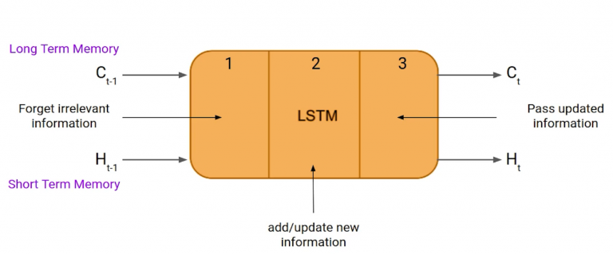
Just like a simple RNN, an LSTM also has a hidden state where H(t-1) represents the hidden state of the previous timestamp and Ht is the hidden state of the current timestamp. In addition to that LSTM also have a cell state represented by C(t-1) and C(t) for previous and current timestamp respectively.

Slide 60
Forget Gate
LSTM network, the first step is to decide whether we should keep the information from the previous timestamp or forget it.
Input Gate
Input gate is used to quantify the importance of the new information carried by the input.
Output Gate
Output gate, which is pretty similar to the two previous gates.

